Slide 1
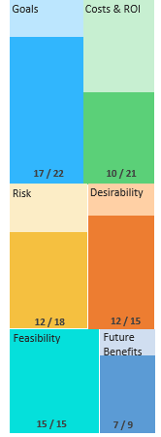
74/100
Project Score
Emergency Medicine Experience – Human Centered Design
EM HCD
Short Name
Recommend
Project Profile
Services Requested
New
Request Type
$520-1M+
Total Cost
100%
VEO Cost
unknown
3 yr ROI
Human Centered Design (HCD) research Journey Map Project Management Collaboration with VHA
Description of Project Request
Human Centered Design (HCD) research to develop a Journey Map of the Veteran experience with Veterans Health Administration (VHA) Emergency Medicine (EM) and outline recommendations. EM includes emergency room and urgent care centers across VHA. EM is one of VHA’s top 3 priorities, per Steve Young.
Costing Details
Phase 1: ($270K) OPM Lab: 16 weeks over 6 mo. Problem Framing/Scoping Workshop: $20K Research Cycle: $250K FTE 2x50% @ 16weeks: $36K Phase 2: Option 1 – Additional OPM Lab Research Cycles: $250K each OPM Design support: Cost TBD Option 2- New FY19 Contract (Total: $756) High Complexity research/design task: $640K estimated Travel: $45K FTE: $71K
Project Background
VHA EM has been working collaboratively with community care to evaluate ways to reduce the cost of community emergency care, currently at$1 Billion annually. VA has very little qualitative data to understand why a Veteran chooses VA vs. Community Care for emergency and urgent care services. Insights from this project will be used to drive the future of VA EM care for the next 5+ years. This project intersects with both Inpatient Experience and Community Care research that VEO is currently undertaking.
Project Deliverables
Customer insight report based on HCD findings; cross product landscape; compelling visual artifact (Journey map); presentation; prioritized list of potential design opportunities for improving the EM experience; recommendations for implementation.
Scoring Matrix Outputs
180028
Project ID
Dr. Chad Kessler
Applicant
N/A
Intake
06/28/2018
Interview
pending
VEO Decision

Slide 2
BACKUP SLIDES

Slide 3
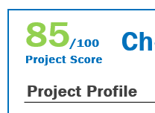
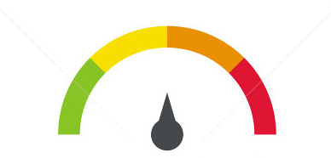
VEO Intake Scoring Process
VEO Portfolio Management scores a project based on 26 factors across 6 domains. The result is a project score out of 100.
Based on the score, a recommendation for further action is forwarded to the Board.*
Recommendation options are: Approve, consider, discuss, or reject.
Thresholds for recommendation ranges are based on where the project score falls on a normal distribution.
Project Selection Criteria
σ | Scores | Action
>1σ | >61 | Recommend
µ-1σ | 51-61 | Consider
-1σ-µ | 41-51 | Discuss
<-1σ | <41 | Disqualify
Item
Weights
Answers on Intake Form
Interview insights
Information from project documentation/reference materials submitted
Domain
Weights
Item scores
Normalization
The intake scoring process provides a consistent and replicable methodology to compare projects.
*VEO Portfolio Management Board has not yet been activated. VEO executive leadership is reviewing requests in lieu of the Board.

Slide 4
Domain Definitions
Items on the Intake Scoring Matrix are grouped into the following six Domains
Goals - Do the objectives of the project align with White House, SecVA, Modernization, and VEO mission, priorities, and initiatives? Desirability - Are the anticipated outcomes of high value? Who benefits: Employees, Enterprise, Veterans? How important is the problem that the applicant is attempting to solve? Costs & Return On Investment (ROI) - Is the cost of fulfilling this request known? What portion of the costs will VEO cover? Is there a business case to support the request? Will this project reduce costs/future financial burden? Risk - Have the necessary resources been committed by any external stakeholders? Is there a plan to measure progress/success? Is this a high risk project? Are there any technical/system dependencies? Feasibility - Is the timeline flexible; does it match VEO staff availability? Does the requested support match VEO staff skills? Will VEO be able to deliver a viable product? Future Benefit - Benefits gained if the project were to be broadened beyond its current scope. Could the project eventually be leveraged across the organization? Are there other secondary (future) benefits? What is the Level of effort and time required to bring the project to scale and derive additional benefits?

Slide 5
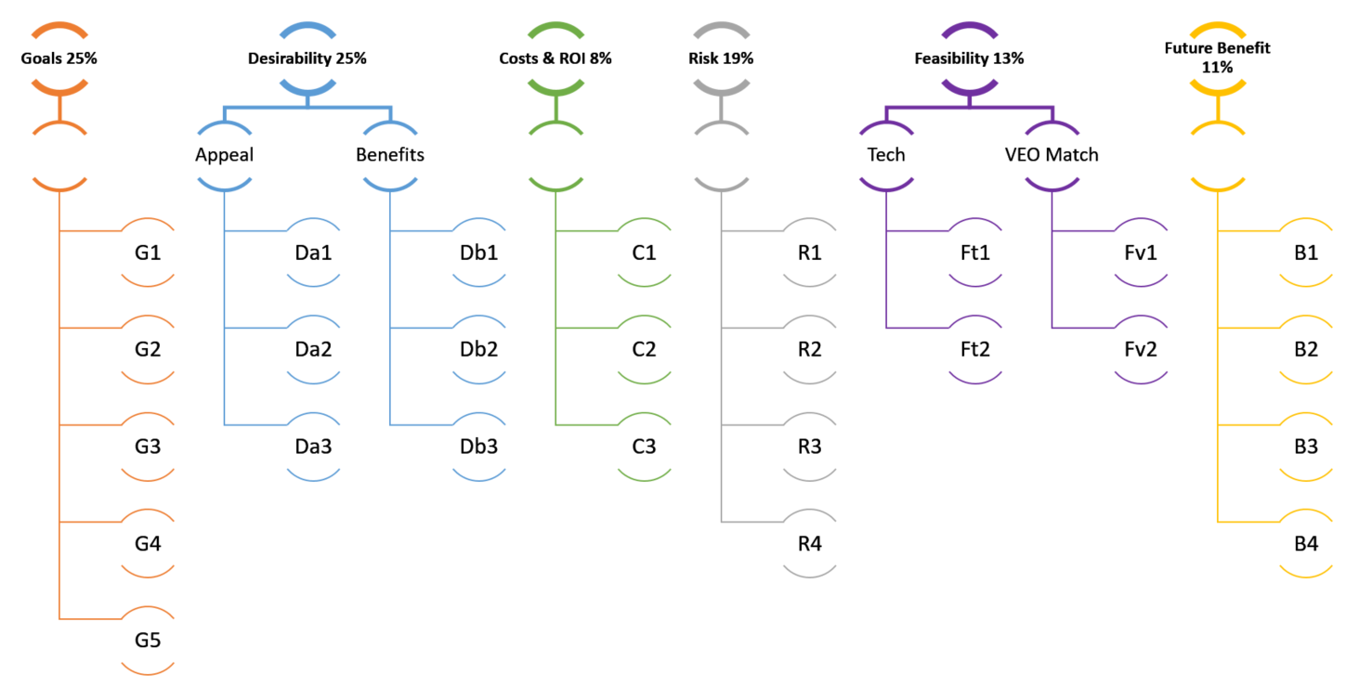
Domain Weights
Items within Domains have equal weights. Domains are weighted by importance using the Analytic Hierarchy Process.

